Slide 1
Demystifying Learning

Slide 2
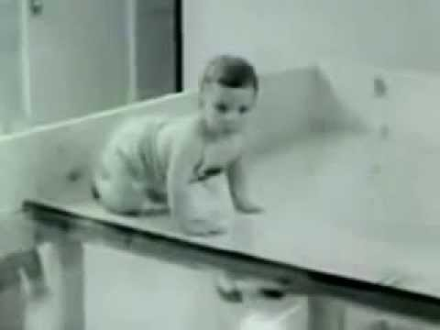
Visual Cliff Experiment
Gibson and Walk (1960), Cornell University.
Depth perception in human and other animal species.
Experiment ↔ Learning ?
Learning: do task-> fail -> experience -> repeat till success.
Source : https://en.wikipedia.org/wiki/Visual_cliff

Slide 3
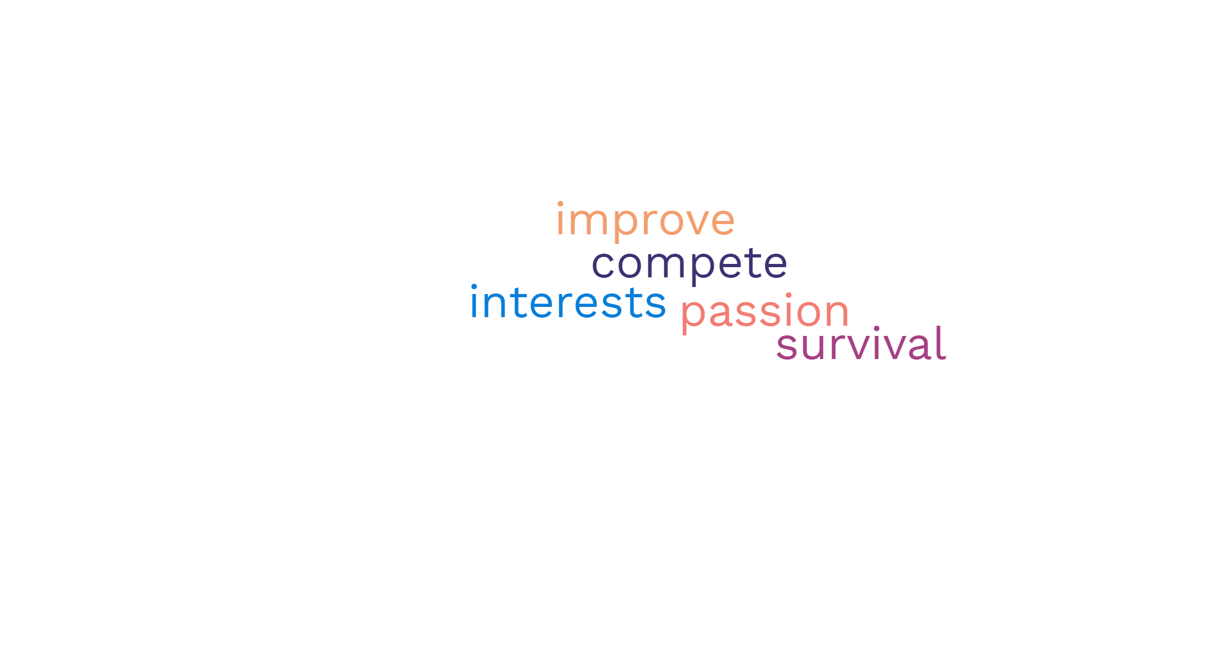
Need for Learning
Blocks of Learning:
Information
Knowledge
Experience

Slide 4
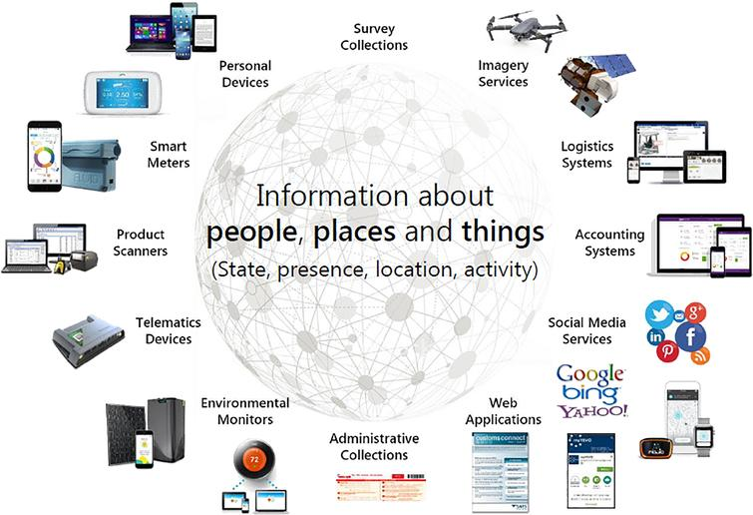
Need for Machines
Data
Time (Latency)
Services / Applications
Source : https://content.iospress.com/articles/statistical-journal-of-the-iaos/sji190595

Slide 5
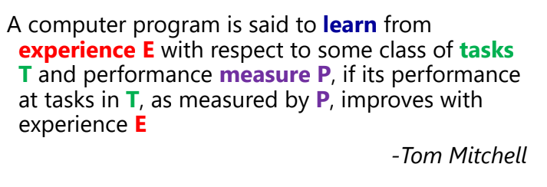
Learning
Source : www.facweb.iitkgp.ac.in/~debdoot/courses/AI61002/Spr2020/

